Slide 1
Adrenal Gland and Stress Hormones

Slide 2
Learning Objectives
Name three zones in the adrenal cortex and major regulator(s) of each zone.
Name three steroidogenesis pathways and their major products.
Describe the physiological actions and roles of aldosterone.
Explain briefly the renin-angiotensin system.
Describe the negative feedback regulation of aldosterone and its relationship to blood volume/blood pressure homeostasis.
Describe hepatic and extrahepatic metabolic actions of glucocorticoids. Discuss their relationship.
Name the major hormones secreted from the adrenal medulla. Discuss the differences of epinephrine (epi) and norepinephrine (NE) in cardiovascular actions (physiological levels).
List the major metabolic actions of catecholamines.
Contrast the thresholds for actions vs. plasma levels of epi and NE under common conditions, like exercise, and in the disease pheochromocytoma

Slide 3
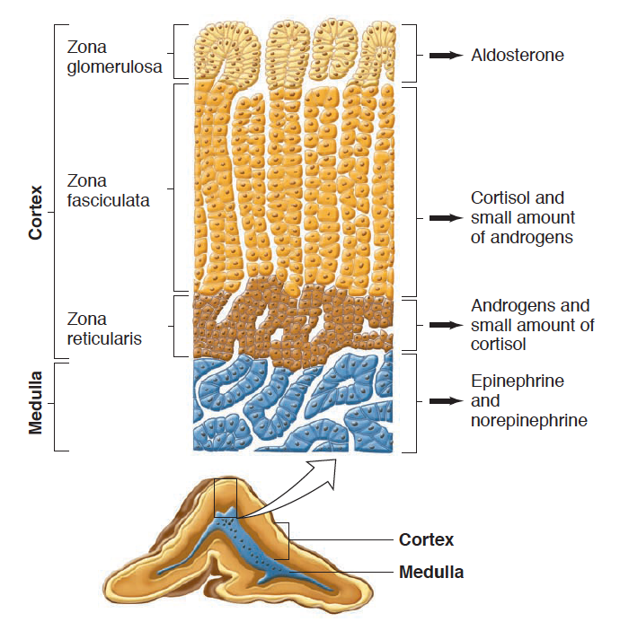
Adrenal Gland Anatomy
Notes:
Recall back to the anterior pituitary that there are specialized cell types that are hormone factories.
We are going to talk about the steroid hormones first, then the biogenic amines

Slide 4
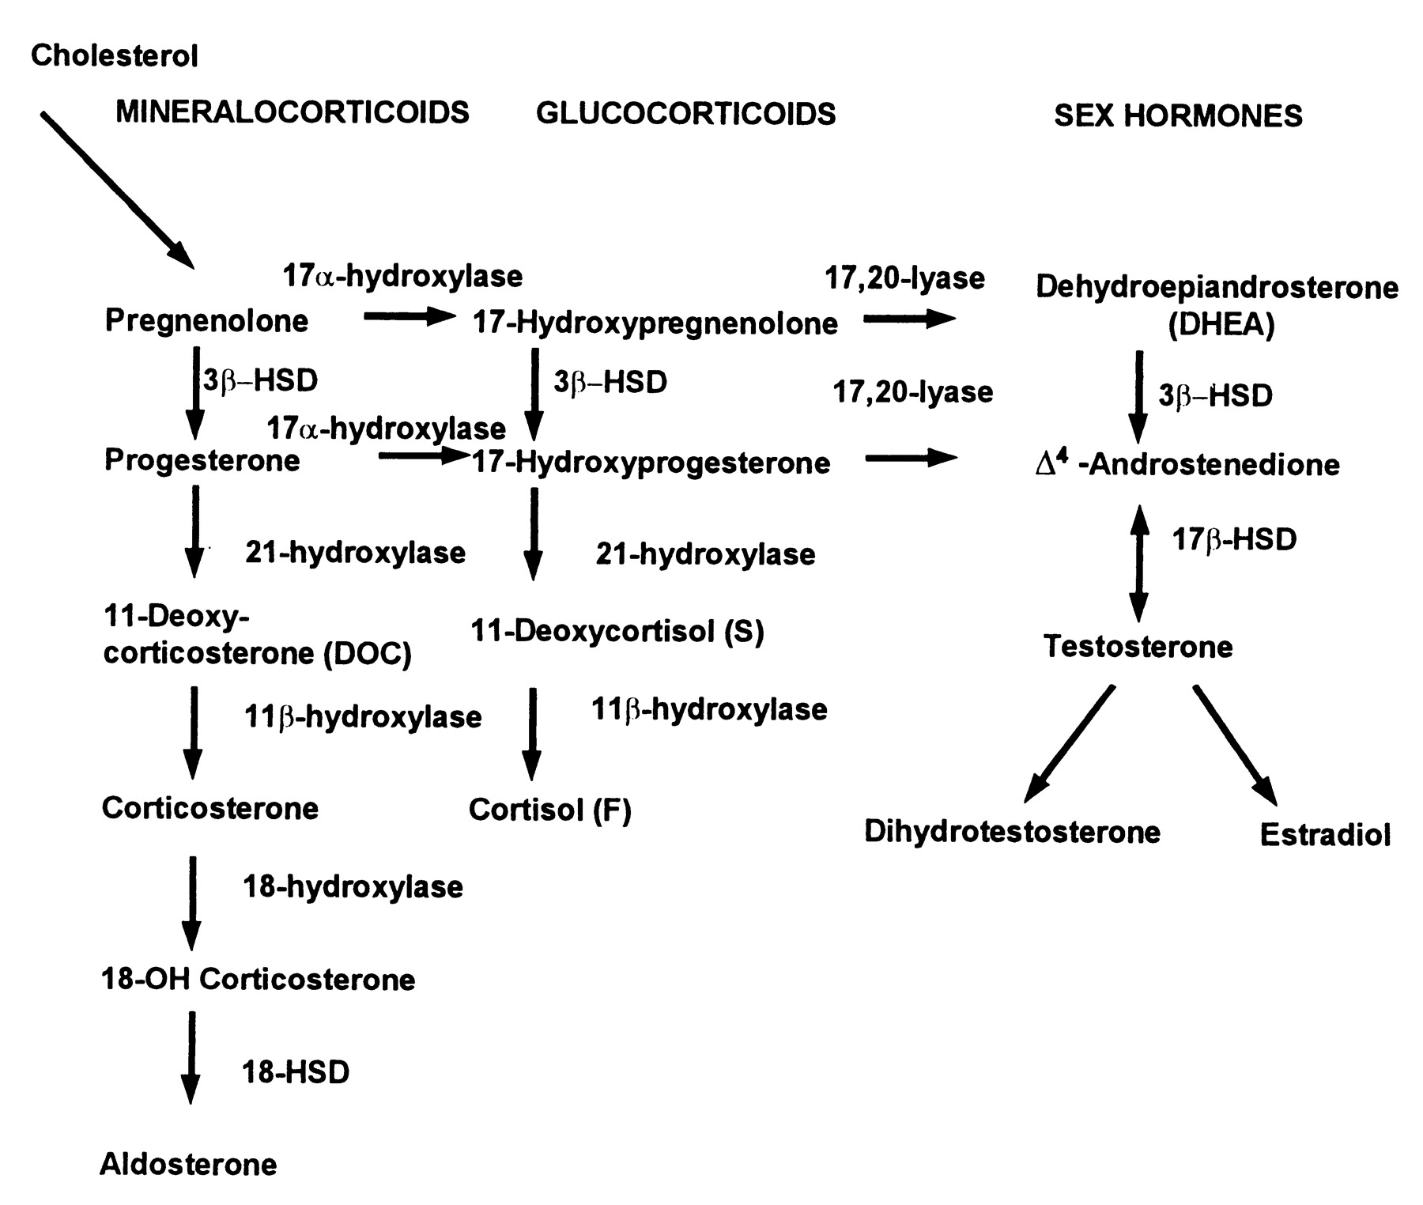
Steroid Hormone Biosynthesis
Maria I. New, and Robert C. Wilson PNAS 1999;96:12790-12797
Notes:
Don’t need to know these enzymes, but you do need to know there are three major pathways

Slide 5
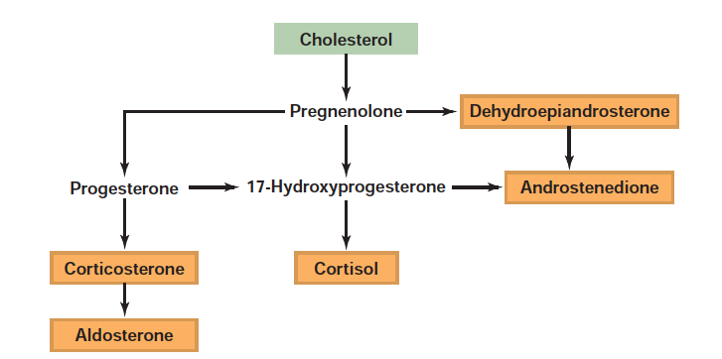
Steroid Hormone Synthesis

Slide 6
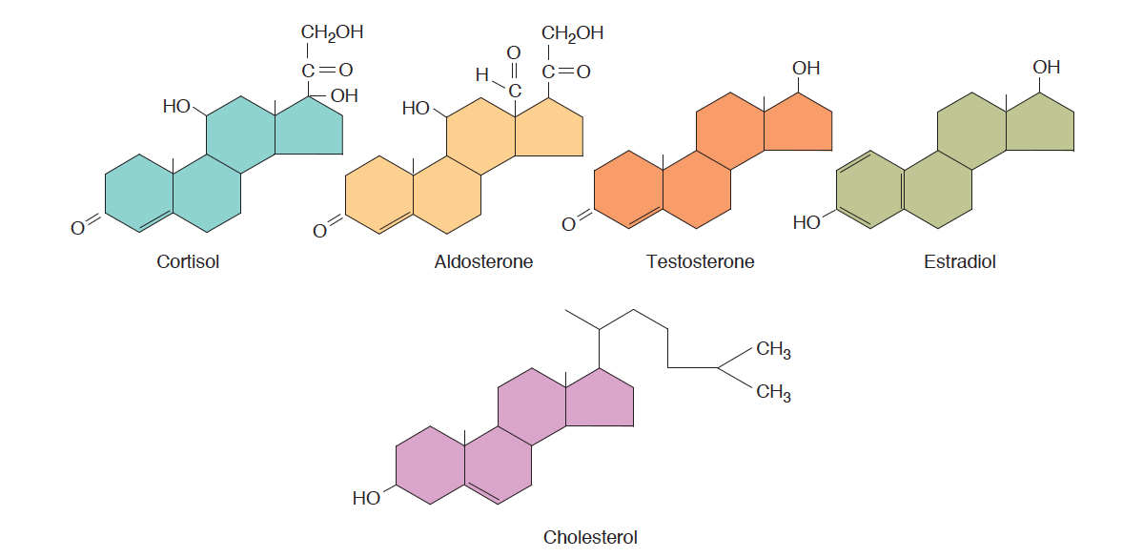
Steroid Hormones Released From Adrenal Medulla
Notes:
Note that cortisol and aldosterone have fairly similar structures

Slide 7
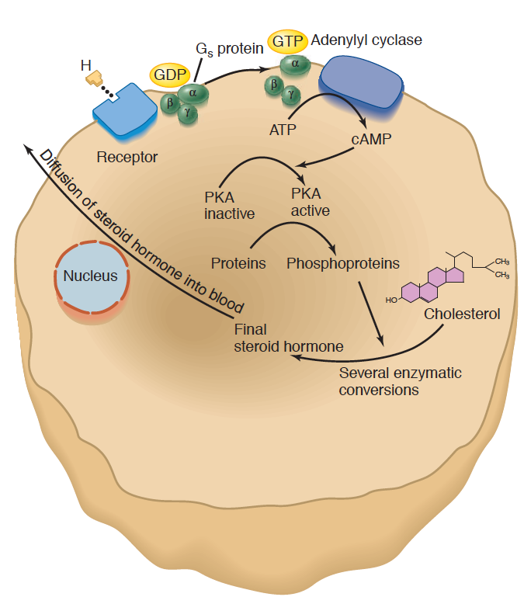
Adrenal Steroid Hormone Synthesis Mechanisms
Signal | Receptor | Hormone
ACTH | MC2R (GPCR - Gs) | Cortisol
Angiotensin II | AGTR1 (GPCR – Gq) | Aldosterone
Notes:
Regulated by increasing the synthesis of the relevant steroids, which are then passively released into the blood

Slide 8
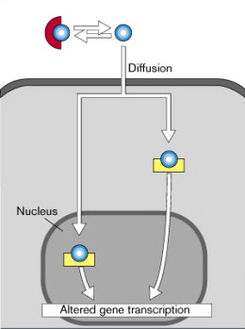
Both Aldosterone and Cortisol Function Through Nuclear Hormone Signaling

Slide 9
Aldosterone Regulates Mineral Balance

Slide 10
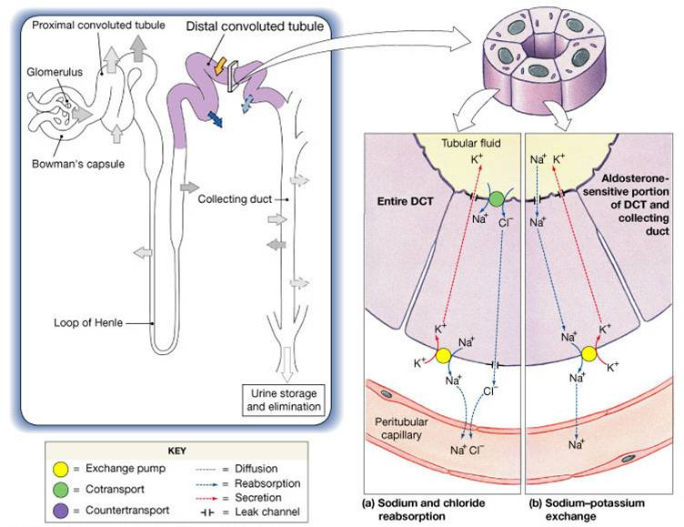
Key Aldosterone Effectors
ENac
Na/K
Notes:
Should be here at 15 minutes

Slide 11
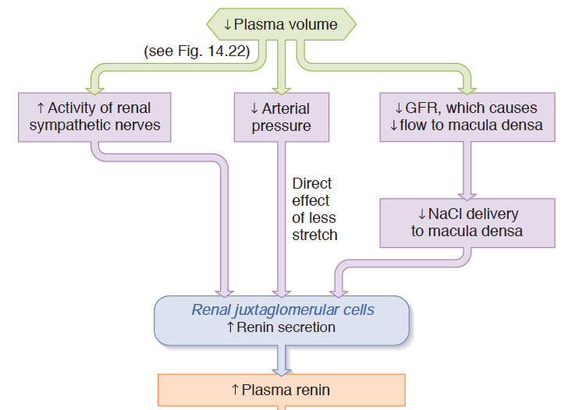
Renin as a Volume/Pressure Sensor
Notes:
Mechanotransduction and sympathetic activity

Slide 12
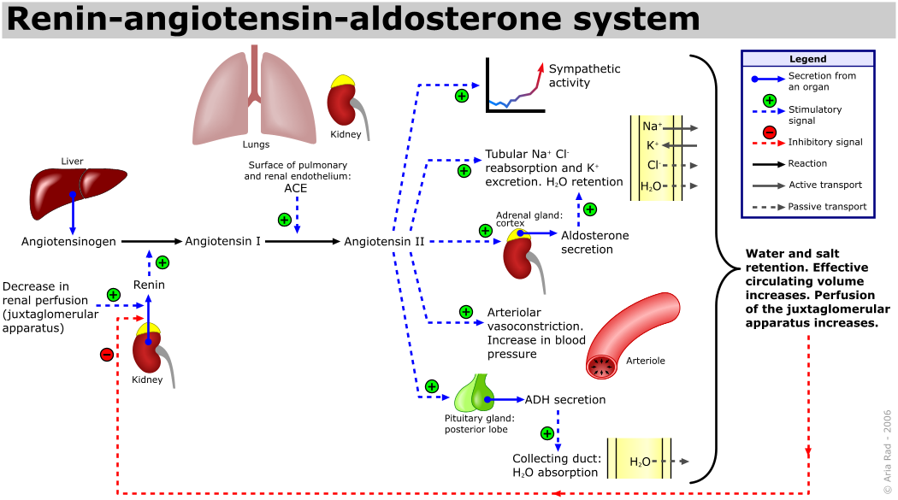
The Renin/Angiotensin System
Notes:
Point out the negative feedback occurs via sensing at the JG cell.
Quick effect via angiotensin, long term effect via aldosterone
Less stretch, less
This is separate to just the effects of vasopressin

Slide 13
Stress Responsive Hormones

Slide 14

Two Types of Stress Response
Adrenaline
Cortisol
Notes:
Short term, need to get away from the snake
Chronically they are better prepared for a snake attack, energy is partitioned in away to be prepared for a snake attack, but long term normal functions such as growth, reproductive function and immunity are still suppressed

Slide 15
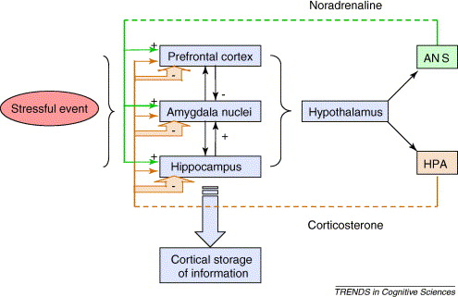
CRH Release

Slide 16
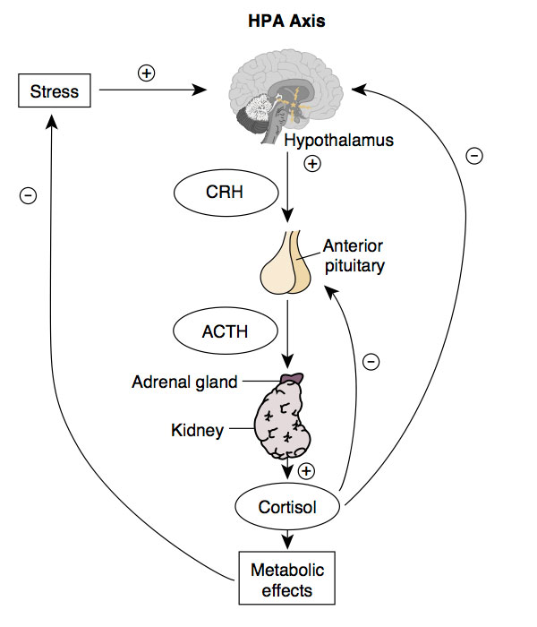
HPA Axis

Slide 17
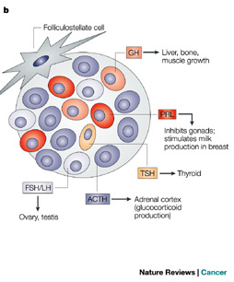
Anterior Pituitary
Hypothalamic | Anterior Pituitary | Cells
CRH | ACTH | Corticotropes
TRH | TSH/Prolactin | Thyrotropes/ Lactotropes
GnRH | LH/FSH | Gonadotropes
GHRH | GH (increase) | Somatotropes
Somatostatin | GH (decrease) | Somatotropes
Asa SL, Ezzat S (2009) The pathogenesis of pituitary tumors. Annu Rev Pathol 4: 97–126. doi:10.1146/annurev.pathol.4.110807.092259.
Notes:
Each cell type is responsible for a particular kind of hormone secretion
Mention all GPCRs

Slide 18
Corticotropin Releasing Hormone
Where is it made? | Hypothalamus (PVN)
What causes its release? | Stress (Synaptic Inputs)
What are its receptors? | CRHR1/2 (Gs)
What tissues does it affect? | Corticotropes in the Anterior Pituitary | ACTH Release
How does it get turned off? | Receptor desensitization, Cortisol Negative Feedback to Hypothalamus, 11BHSD2

Slide 19
ACTH
Where is it made? | Corticotropes of the Anterior Pituitary
What causes its release? | CRH into the hypophysial portal system
What are its receptors? | ACTHR (Gs - GPCR)
What tissues does it affect? | Adrenal Cortex | Cortisol synthesis
How does it get turned off? | Receptor desensitization, Cortisol Negative Feedback to Hypothalamus, Cortisol Negative Feedback to Hypothalamus 11BHSD2

Slide 20
Cortisol Summary
Where is it made? | Adrenal Cortex (Zona fasciculata)
What causes its release? | ACTH (GPCR –Gs)
What are its receptors? | Glucocorticoid Receptor
What tissues does it affect? | Muscle | Protein Catabolism
 | Adipose | Increased Lipolysis, Adipogenesis
 | Liver | Increased Gluconeogenesis
 | Brain | Less Food Intake
 | Immune System | Reduced Th2 Activation
How does it get turned off? | Receptor desensitization, Negative Feedback to Pituitary, Negative Feedback to Hypothalamus, 11BHSD2

Slide 21
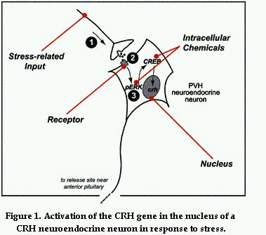
CRH In Response to Stress

Slide 22
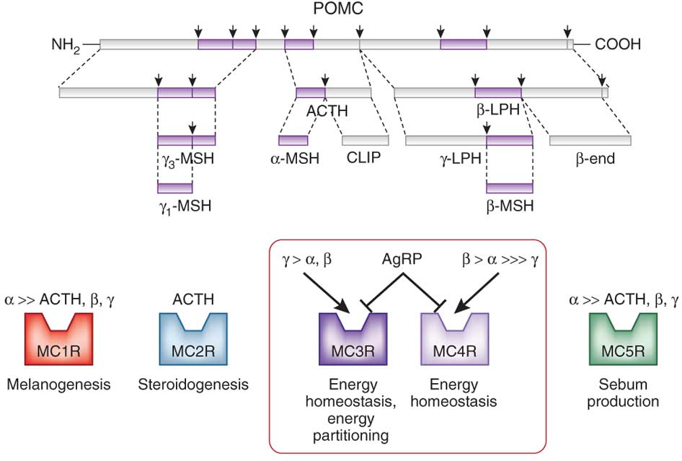
ACTH and other Hormones are Generated from POMC Transcripts

Slide 23
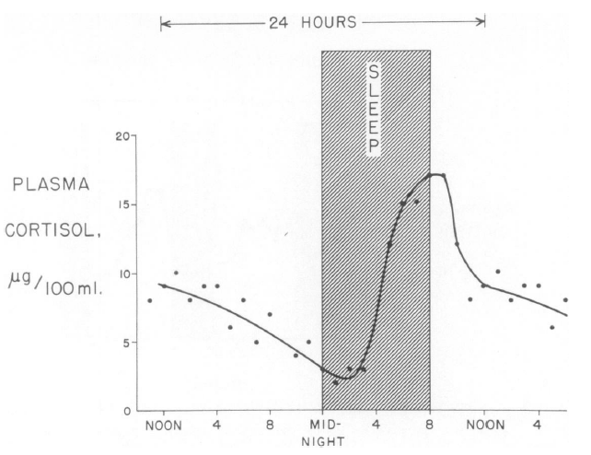
Daily Rhythms of Cortisol Release
Liddle GW (1966) An analysis of circadian rhythms in human adrenocortical secretory activity. Trans Am Clin Clim Assoc 77: 151–160.
Notes:
Related to this, prolonged fasts also elevate cortisol levels

Slide 24
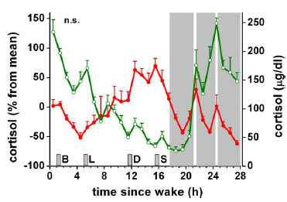
Night Time Workers
Normal
Sleep disrupted
Scheer F AJL, Hilton MF, Mantzoros CS, Shea S A (2009) Adverse metabolic and cardiovascular consequences of circadian misalignment. Proc Natl Acad Sci U S A 106: 4453–4458. doi:10.1073/pnas.0808180106.
Notes:
Fedex workers

Slide 25
Major Chronic Responses to Stress
Shift resources (mainly glucose) towards essential functions
Suppress non-essential functions
Immune system
Reproductive system
Growth
Notes:
Should be here at 25 minutes

Slide 26
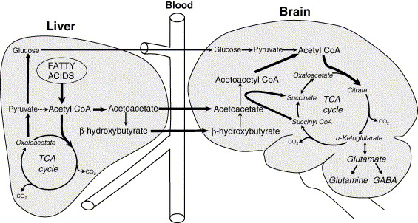
Brain Requires Glucose Supply
Notes:
Dosent store glycogen, limited gluconeogenic capacity
Glucose is produced by a process called gluconeogenesis

Slide 27
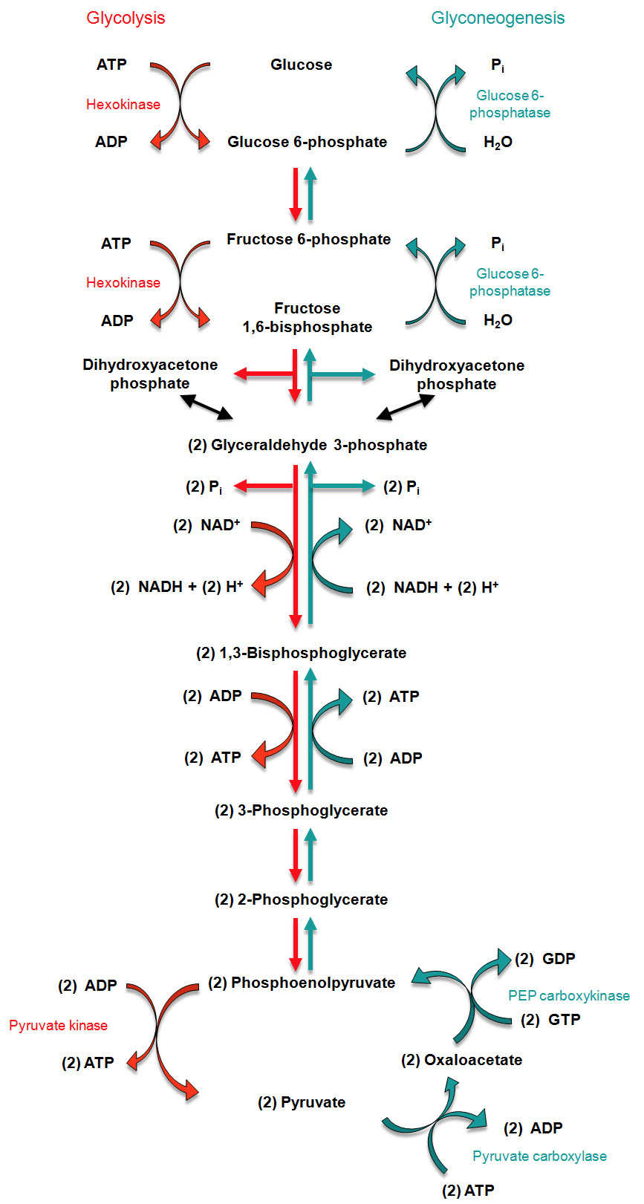
Regulation of Gluconeogenesis
Activation of mRNA transcription
by glucocorticoids in the liver
Notes:
Don’t need to know this, but the flow is going this way. The rate limiting steps are in blue

Slide 28
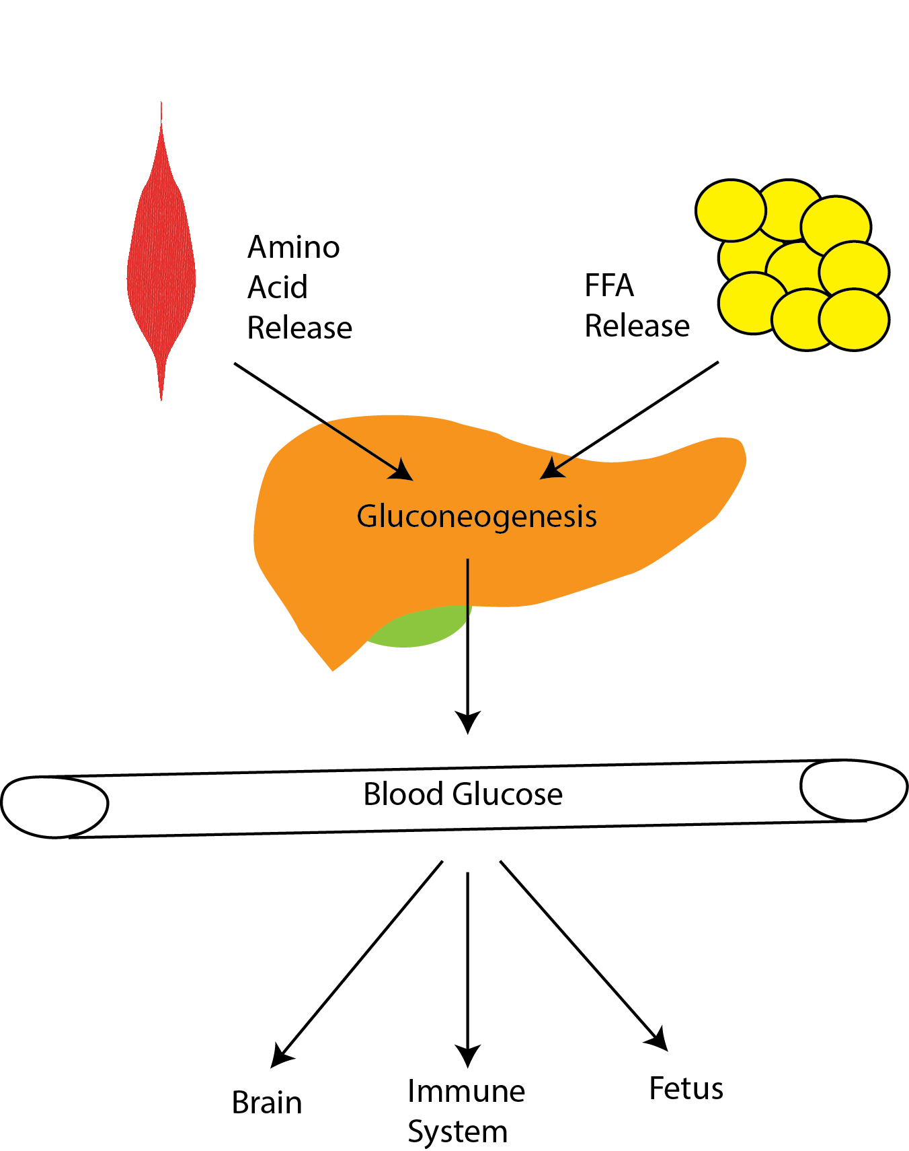
Cortisol Maintains Blood Glucose Levels
Notes:
Induces gluconeogenesis
Induces protein/triglyceride breakdown
Promotes insulin resistance

Slide 29
Three Mechanisms to Maintain Blood Glucose Levels
Promote gluconeogenesis (liver)
Provide substrates for gluconeogenesis (muscle/fat)
Prevent glucose uptake (muscle/fat)

Slide 30
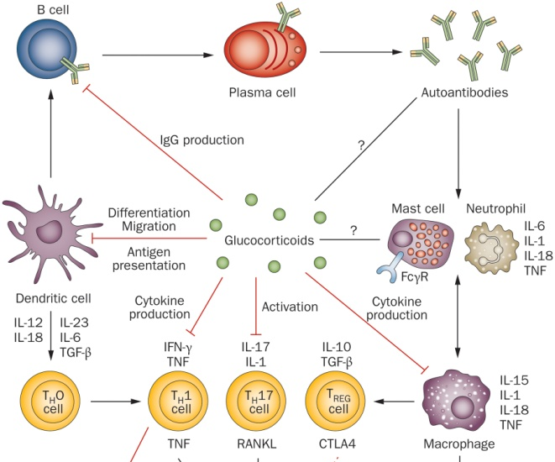
Effects of Cortisol on Immune Function
Notes:
Differentiation of precursors into differentiated immune cells, in both the innate and adaptive immune system

Slide 31
HPA Axis

Slide 32
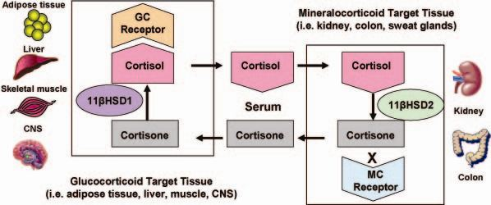
11β-HSD 2 and Local Concentrations of Glucocorticoids
In off target tissues,
or to desensitize normal tissues
Notes:
Problem is that cant restrict steroid hormones from getting into the cells, in the way that you can not express insulin receptors to prevent insulin action
This system accomplishes two things:
Since there is some weak effects of cortisol on the MC receptor this is a way to ensure no abberant MC signaling in the wrong tissues
Secondly this is a way for a tissue to locally control levels are part of a negative feedback mechanism

Slide 33
Adrenal Steroid Hormone Disfunction

Slide 34
Main Types of Endocrine Disfunction
Congenital (Mutations in Hormone Production or Responses)
Tumors which secrete too much hormone
Immune destruction of hormone secreting cells

Slide 35
Common CAH Mutations
Maria I. New, and Robert C. Wilson PNAS 1999;96:12790-12797
Notes:
90% are 21-hydroxylase
Effects of CAH on sex steroids
Smaller number are

Slide 36
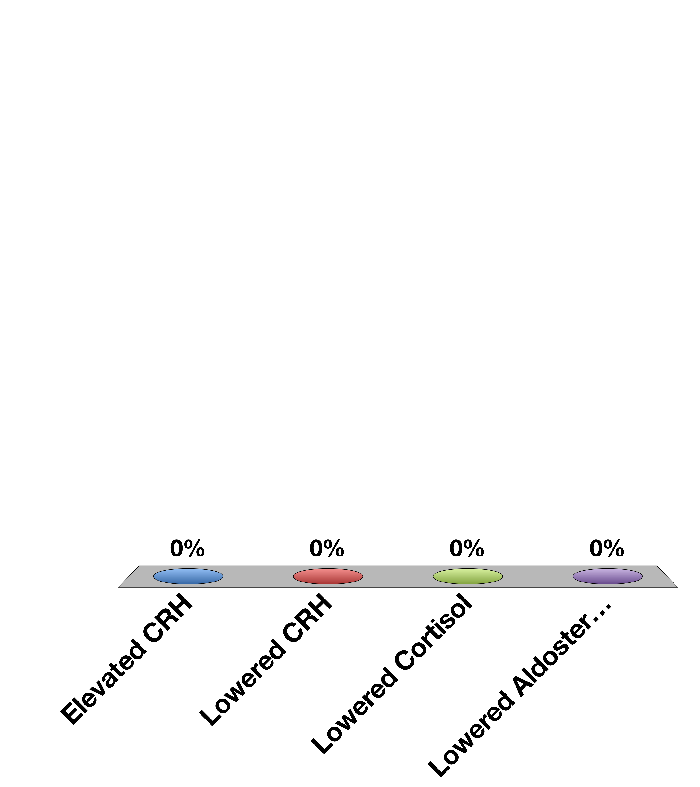
Cushing’s Syndrome (ACTH overproducing tumors) have
Elevated CRH
Lowered CRH
Lowered Cortisol
Lowered Aldosterone
30

Slide 37
Adrenaline Mediates Short-Term Stress Responses
Notes:
Should be here at 40 mins

Slide 38
Epinephrine Summary
Where is it made? | Adrenal medulla
What causes its release? | Sympathetic nervous stimulation
What is its receptor? | Alpha/Beta-Adrenergic Receptors (5 subtypes) | GPCR -> Gs and Gi
What tissues does it affect? | Heart | Increased heart rate
 | Lungs | Increased respiration
 | Vasculature | Vasoconstriction (smooth muscle), vasodilation (skeletal muscle)
 | Liver | Glycogenolysis
 | Fat | Lipolysis
 | Skeletal Muscle | Contraction
How does it get turned off? | Sympathetic signal stops, Receptor desensitization

Slide 39
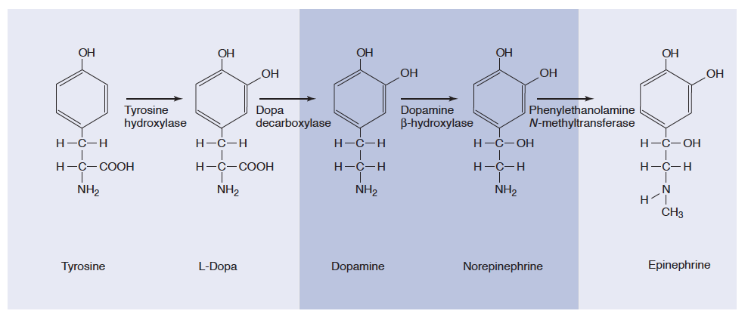
Epinephrine and Norepinephrine
Notes:
Adrenal medulla has high levels of PNMT

Slide 40
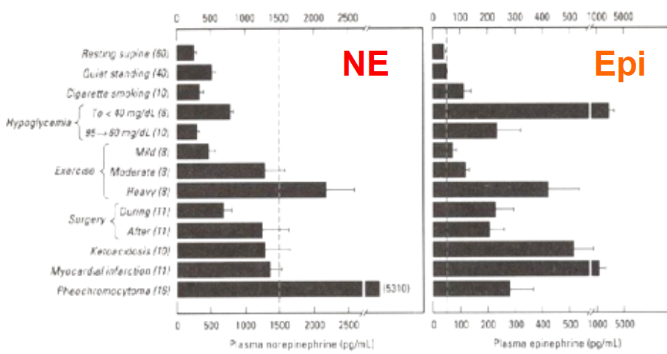
Epinephrine vs Norepinephrine
Dashed line is level in circulation needed to elicit a physiological response

Slide 41
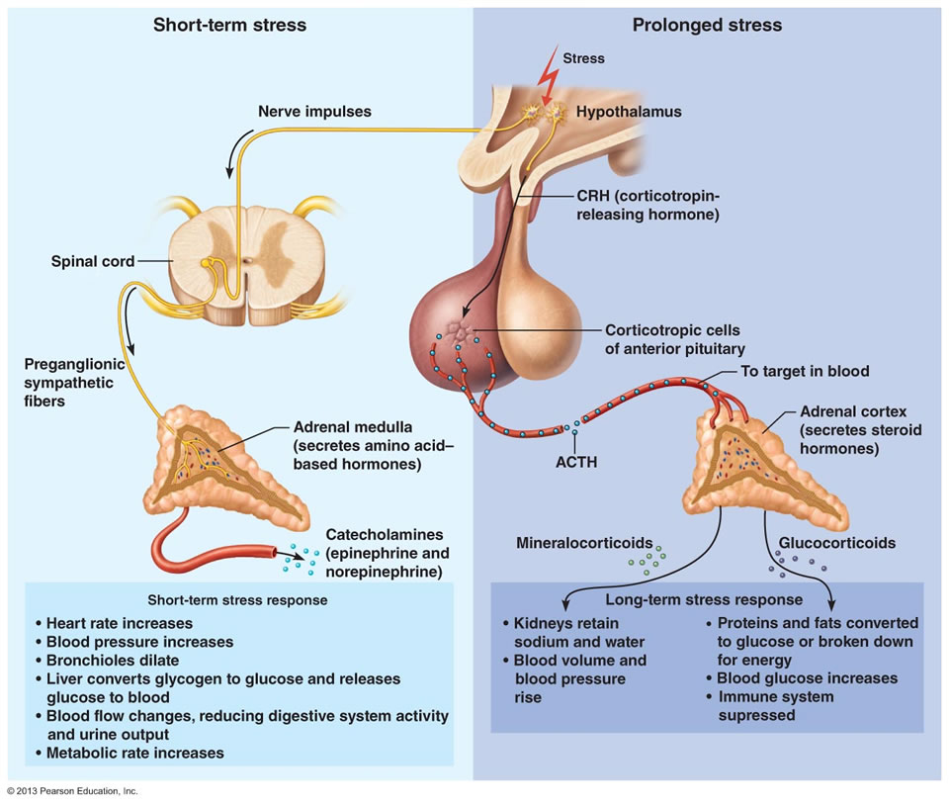
Adrenaline vs Cortisol Release

Slide 42
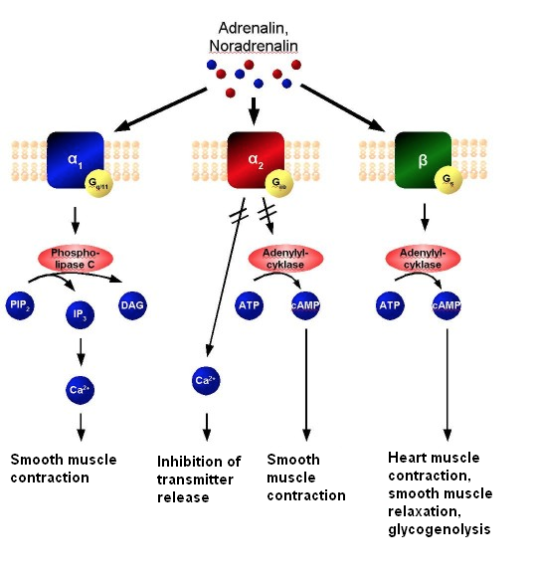
Cardiovascular Roles of Epinephrine
Gq
Gi
Gs
Notes:
Gi/Gq vasoconstriction
Gs vasodilation and heart muscle contraciton

Slide 43
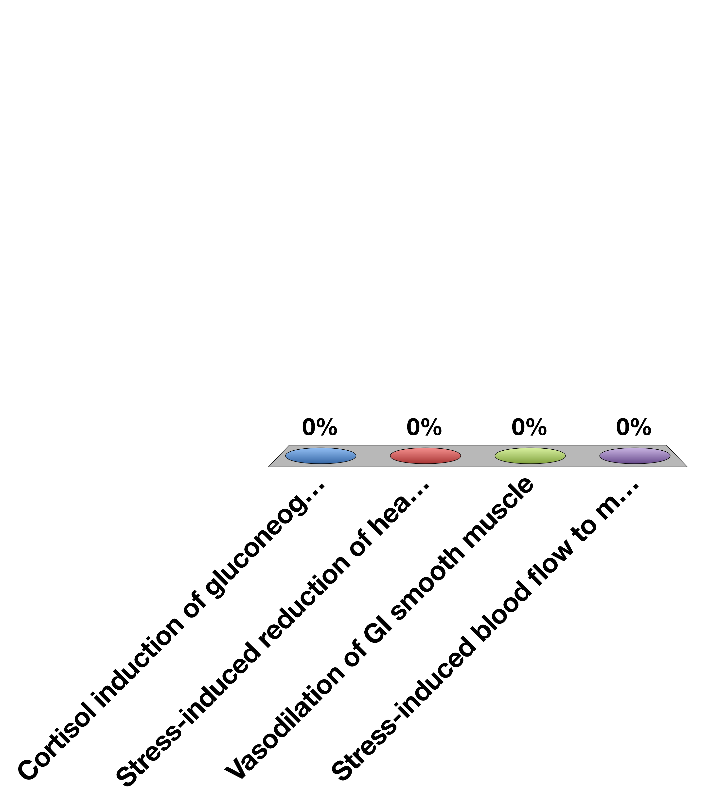
What would a beta blocker prevent?
Cortisol induction of gluconeogenesis
Stress-induced reduction of heart rate
Vasodilation of GI smooth muscle
Stress-induced blood flow to muscle
30

Slide 44
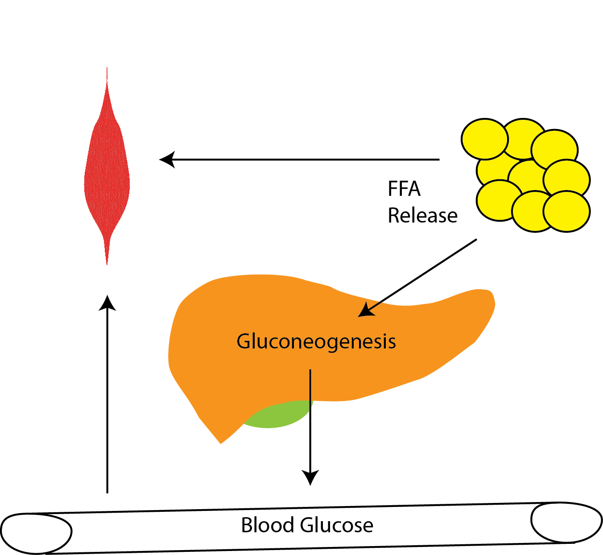
Metabolic Roles of Epinephrine
Cortisol
Epinephrine
Notes:
Discuss similarities and differences between cortisol and epinephrine.
Spend some time, talking about why these differences exist

Slide 45
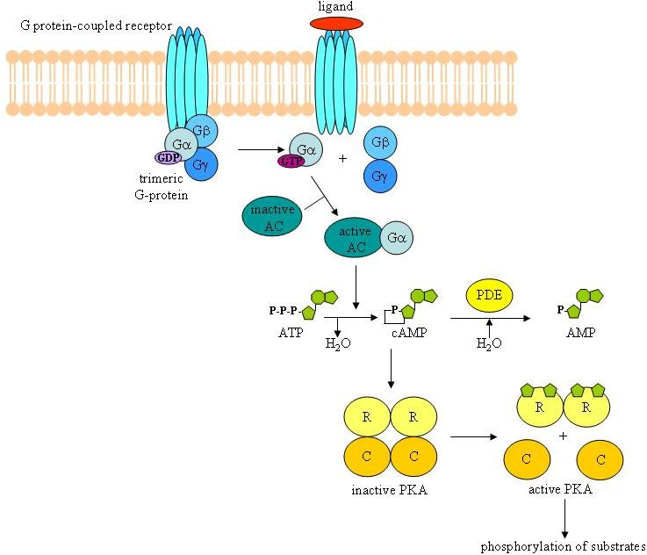
Epinephrine Binds B-AR/Gs in Skeletal Muscle, Liver and Fat Tissue

Slide 46
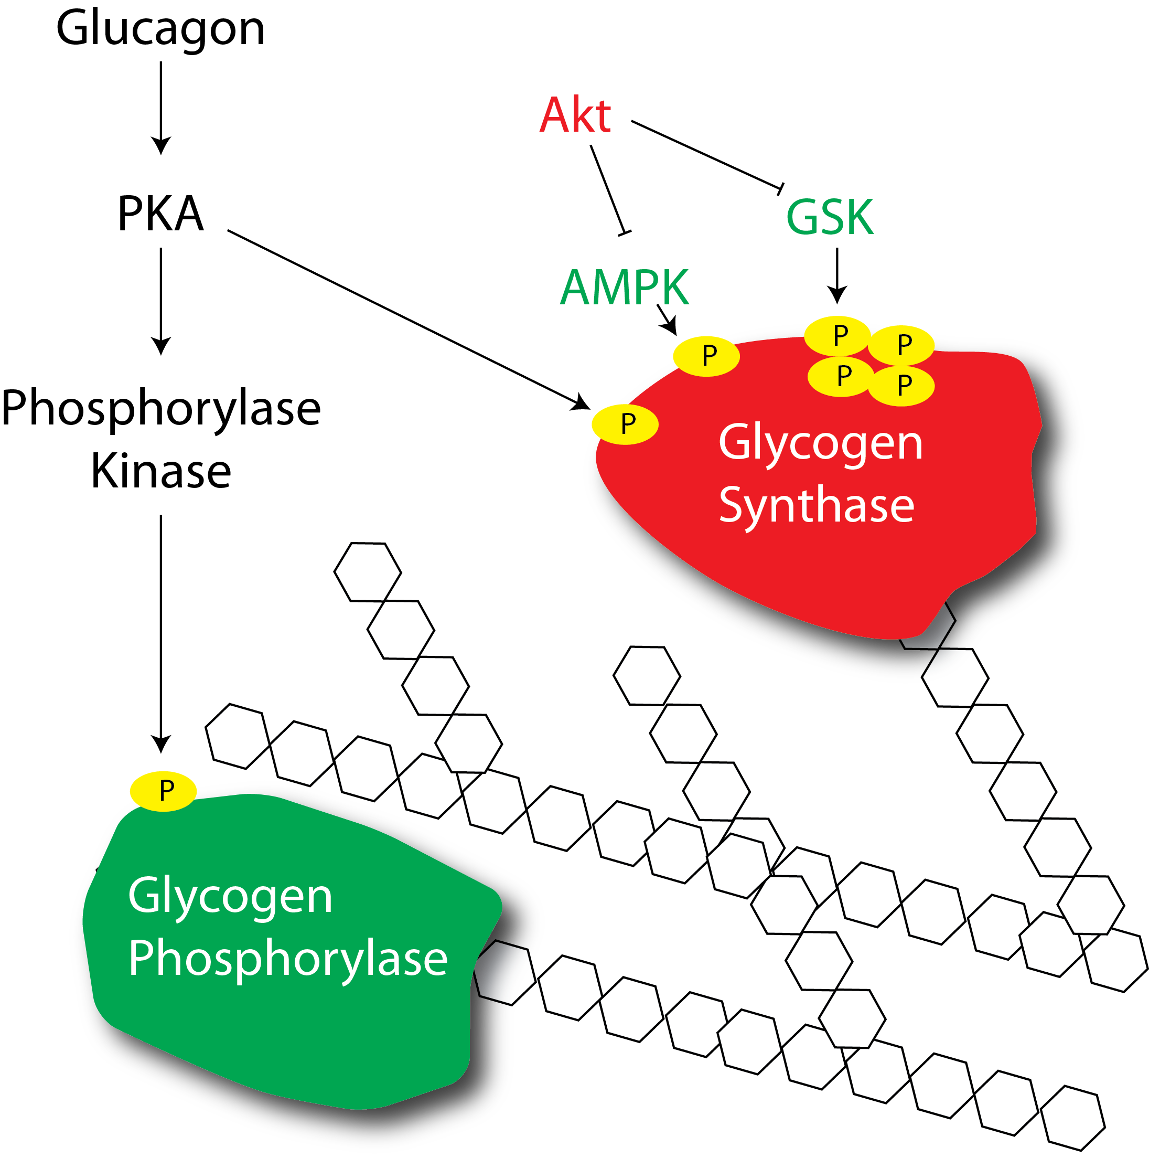
Epinephrine Mediated Activation of Glycogenolysis

Slide 47
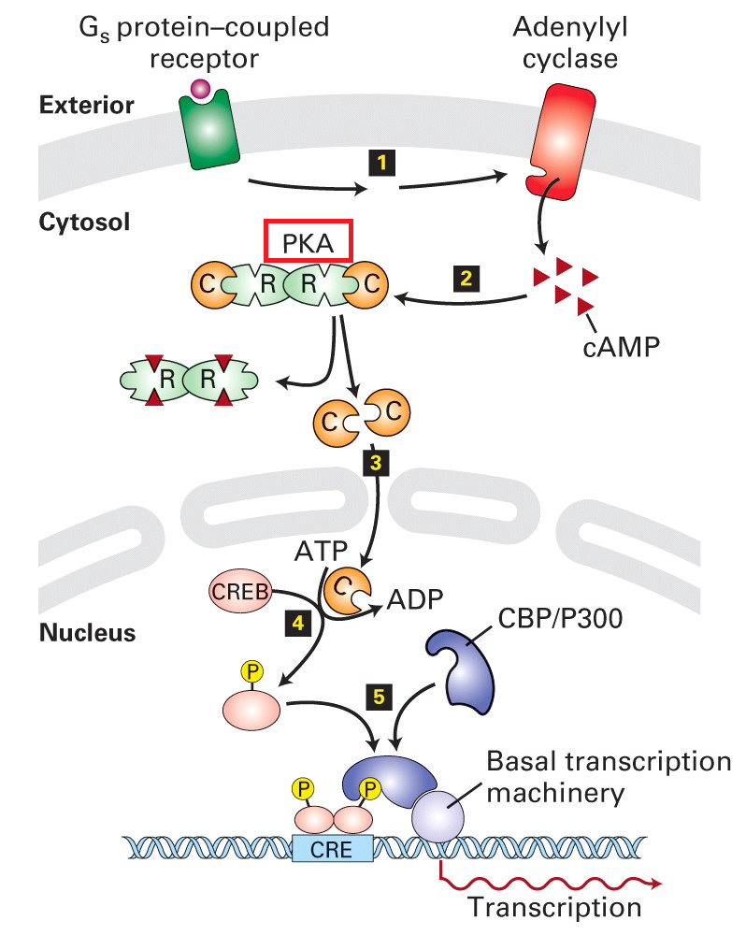
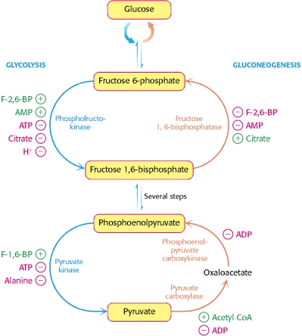
Dual Effects of Epinephrine on Gluconeogenesis in the Liver
PKA
PFK-2
Post-Translational Induction of Gluconeogenesis
Gluconeogenic Gene Transcription

Slide 48
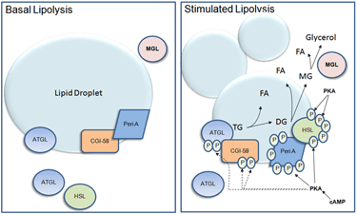
Effects of Epinephrine on Lipid Breakdown

Slide 49
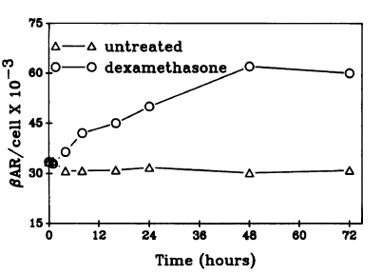
Short Term and Long Term Stress
Chronic Stress
Acute Stress
Cortisol
Epinephrine
Elevated Transcription of
Beta-Adrenergic
Receptors
Glucocorticoid
Receptor
Higher sensitivity
towards epinephrine
Hadcock JR, Malbon CC (1988) Regulation of beta-adrenergic receptors by “permissive” hormones: glucocorticoids increase steady-state levels of receptor mRNA. Proc Natl Acad Sci U S A 85: 8415–8419. doi:10.1073/pnas.85.22.8415.

Slide 50
Pheochromocytoma
Tumor that constitutively secretes adrenaline or noradrenaline
What cardiovascular and molecular phenotypes would this person have?
How could you treat this person?
Notes:
Spend some time discussing

